Slide 1

Macroeconomics
Sixth Canadian Edition
Chapter 7
Economic growth: Malthus and Solow
Copyright © 2021 Pearson Canada Inc.
Notes:
If this PowerPoint presentation contains mathematical equations, you may need to check that your computer has the following installed:
1) MathType Plugin
2) Math Player (free versions available)
3) NVDA Reader (free versions available)

Slide 2
Chapter 7 Topics
Economic growth facts
Malthusian model of economic growth
Solow growth model
Growth and the distribution of income
Growth accounting

Slide 3
Canadian Per Capita Real Income Growth
Except for the Great Depression and World War II, growth in Canadian per capita real income has not strayed far from 2% per year since 1870.

Slide 4
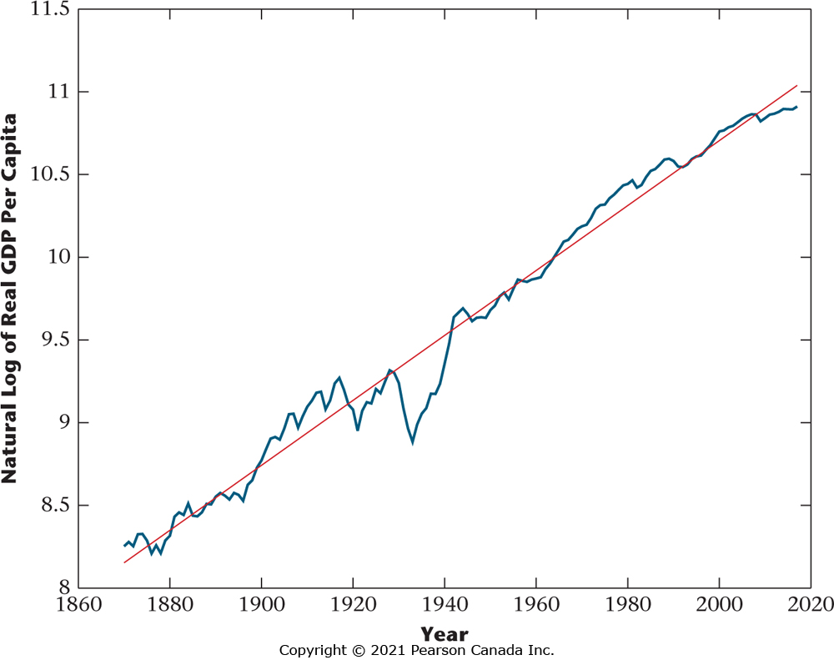
Figure 7.1 Natural Log of Real per Capita Income in Canada, 1870-2017
A straight line provides a good fit. Growth in per capita income in Canada has not strayed far from 2% per year for this period.

Slide 5
Real Per Capita Income and the Investment Rate
Across countries, real per capita income and the investment rate are positively correlated.

Slide 6
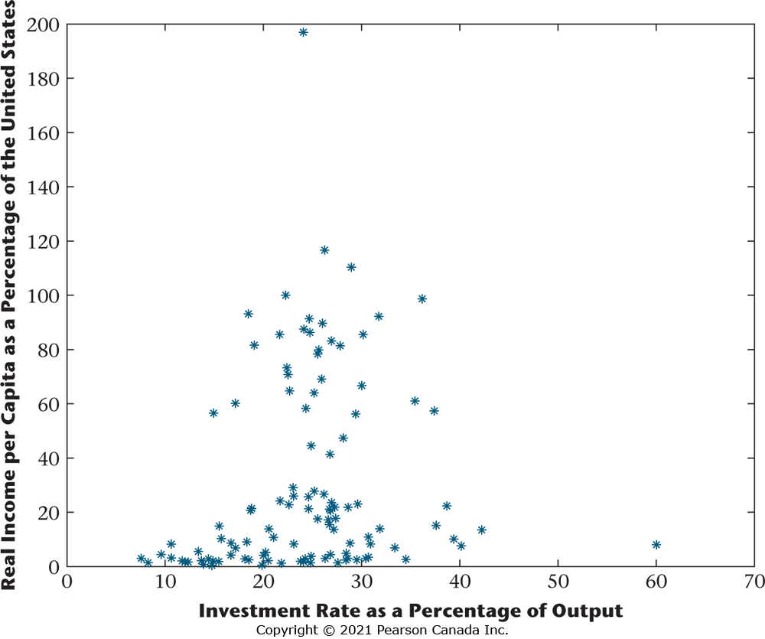
Figure 7.2 Real Income Per Capita vs. Investment Rate
The figure shows a positive correlation across the countries of the world between real income per capita and the investment rate.

Slide 7
Real Per Capita Income and the Rate of Population Growth
Across countries, real per capita income and the population growth rate are negatively correlated.

Slide 8
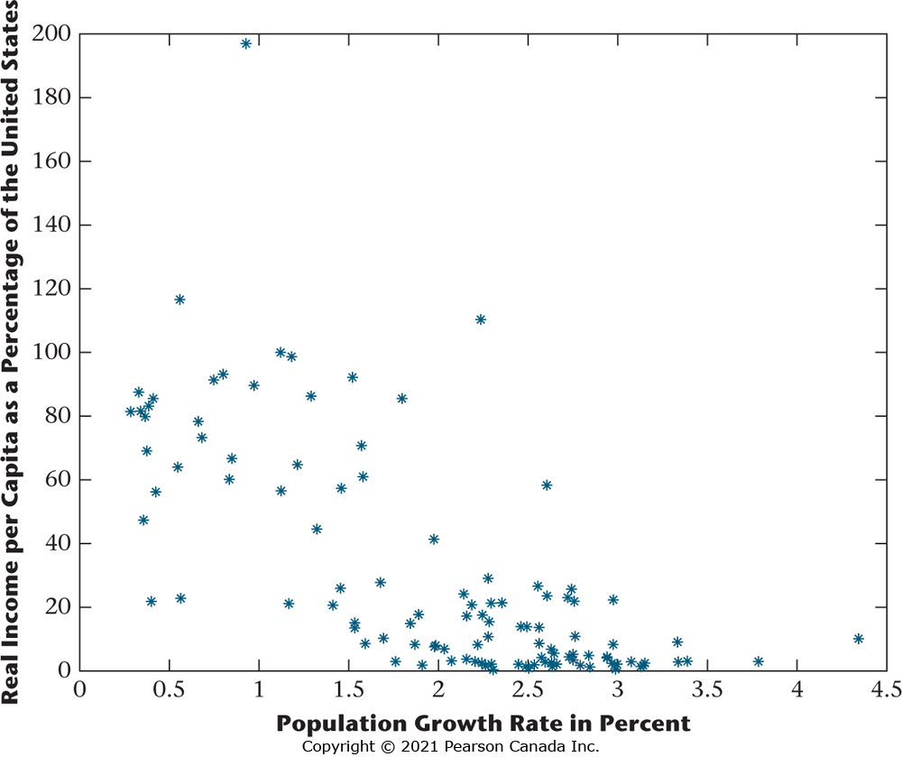
Figure 7.3 Real Income Per Capita vs. the Population Growth Rate
The figure shows a negative correlation across the countries of the world between output per worker and the population growth rate.

Slide 9
Real Per Capita Income and Per Capita Income Growth
There is no tendency for rich countries to grow faster than poor countries, and vice-versa.
Rich countries are more alike in terms of rates of growth than are poor countries.

Slide 10
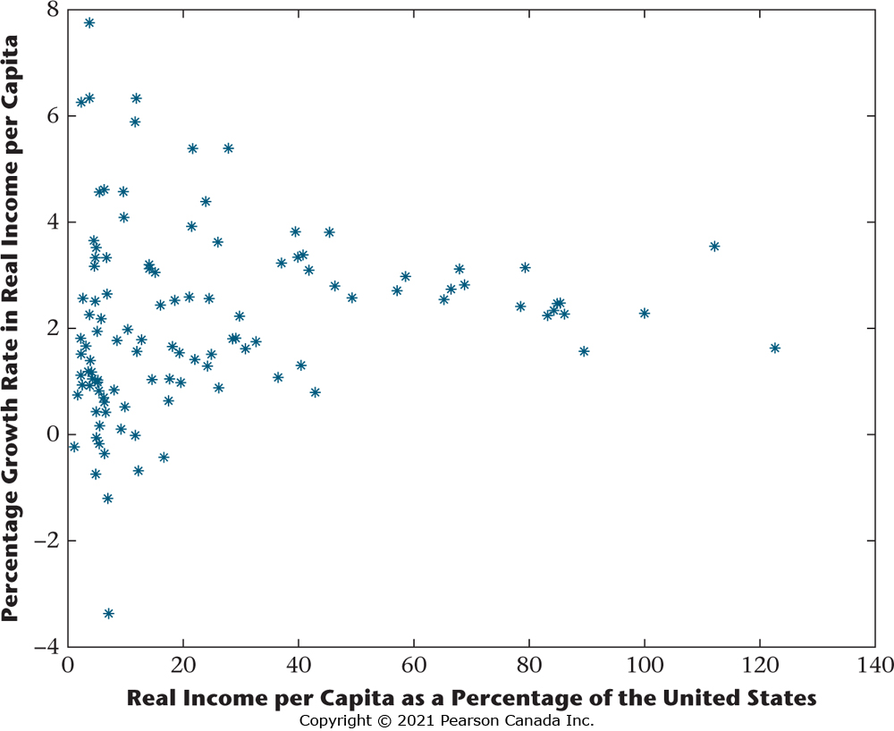
Figure 7.4 Growth Rate in per Capita Real Income vs. Real Income per Capita for the Countries of the World
There is no correlation between the growth rate of real income per capita and the level of real income
per capita for the countries of the world. Rich countries are more alike in terms of their growth rates than are poor countries.

Slide 11
A Malthusian Model of Economic Growth
This model predicts that a technological advance will only increase population, with no long-run change in the standard of living.

Slide 12

Production Function
Output is produced from land and labour inputs.
$$Y=zF(L,N)$$

Slide 13
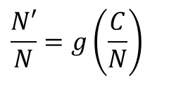
Evolution of the Population
Population growth is higher the higher is per-capita consumption.
$$\frac{N′}{N}=g\left(\frac{C}{N}\right)$$

Slide 14

Equilibrium Condition
In equilibrium, consumption equals output produced.
$$C=zF(L,N)$$

Slide 15
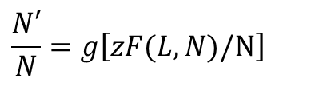
Equilibrium Evolution of the Population
This equation describes how the future population depends on current population.
$$\frac{N′}{N}=g\left[zF(L,N)\text{/}\text{N}\right]$$

Slide 16
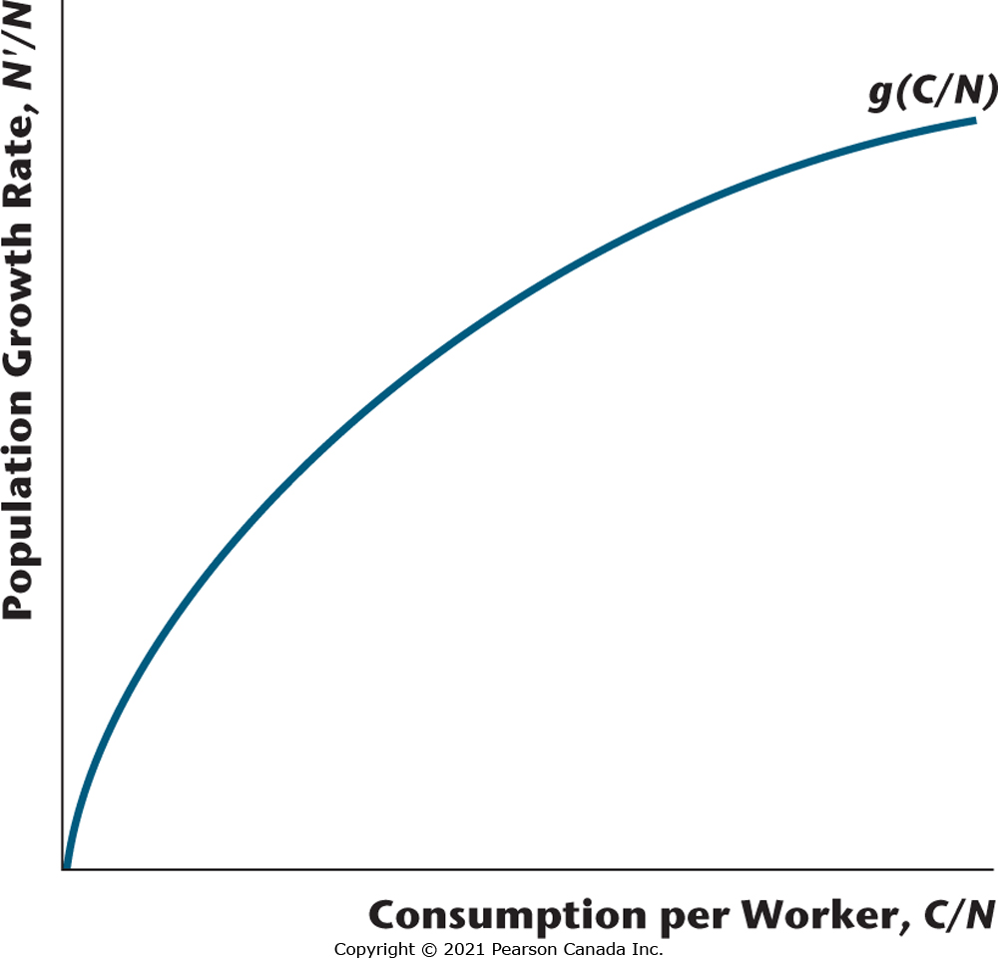
Figure 7.5 The Relationship Between Population Growth and Consumption per Worker
Population growth depends on consumption per worker in the Malthusian model.

Slide 17
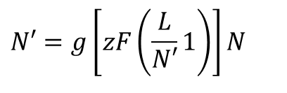
How Population Evolves in Equilibrium
$$N′=g\left[zF\left(\frac{L}{N′}1\right)\right]N$$

Slide 18
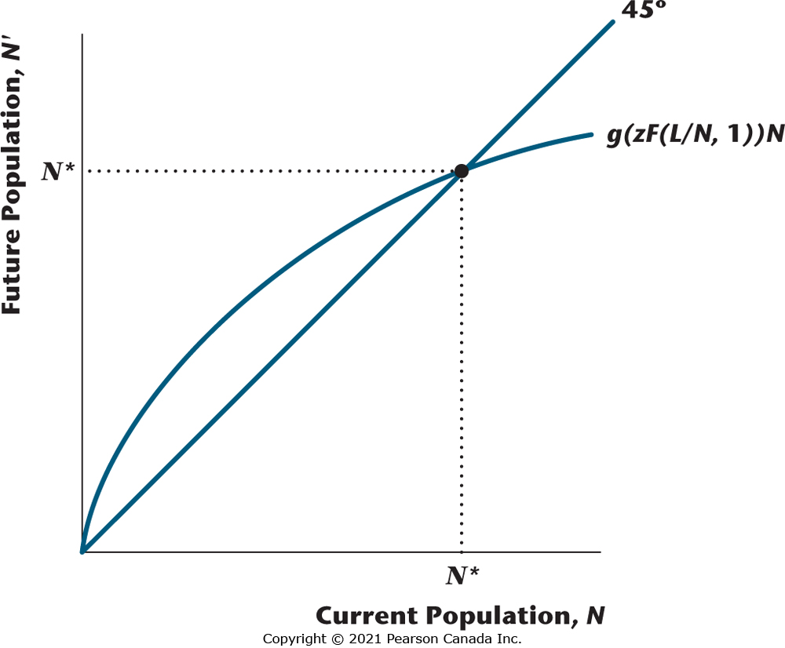
Figure 7.6 Determination of the Population in the Steady State
In the figure, N* is the steady state population, determined by the intersection of the curve and the 45° line. If N > N* then N’< N and the population falls over time, and if N < N* then N’ > N and the population rises over time.

Slide 19

The Per-Worker Production Function
$$y=Zf(I)$$

Slide 20

Equilibrium Condition in Per-Worker Form
$$c=Zf(I)$$

Slide 21
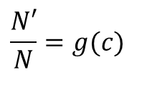
A Steady State Condition
Population growth is increasing in consumption per worker, c
$$\frac{N′}{N}=g(c)$$

Slide 22
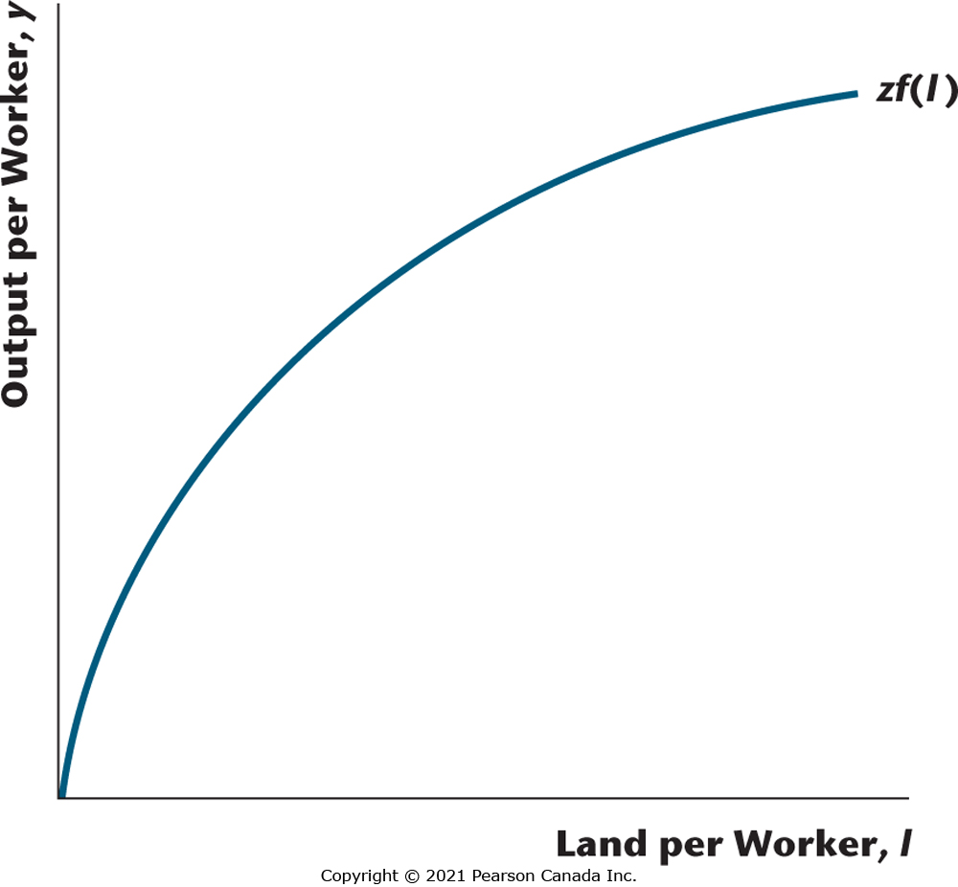
Figure 7.7 The Per-Worker Production Function
This describes the relationship between output per worker and land per worker in the Malthusian model, assuming constant returns to scale.

Slide 23
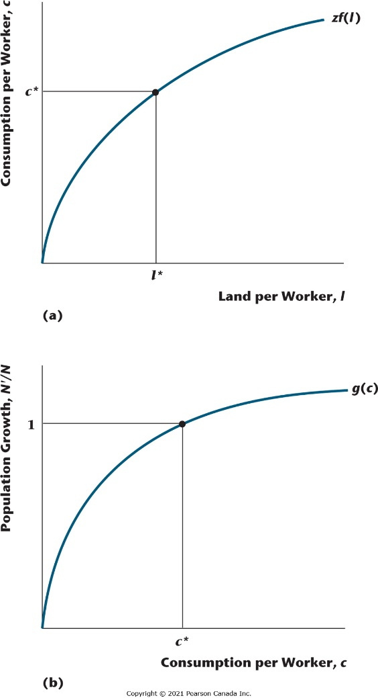
Figure 7.8 Determination of the Steady State in the Malthusian Model
In panel (b), steady-state consumption per worker, c*, is determined as the level of consumption per
worker that implies no population growth. Given c*, the quantity of land per worker in the steady state, l*, is determined from the per-worker production function in panel (a).

Slide 24
An Increase in z in the Malthusian Model
If z increases, this shifts up the per-worker production function.
In the long run, the population increases to the point where per capita consumption returns to its initial level.
There is no long-run change in living standards.

Slide 25
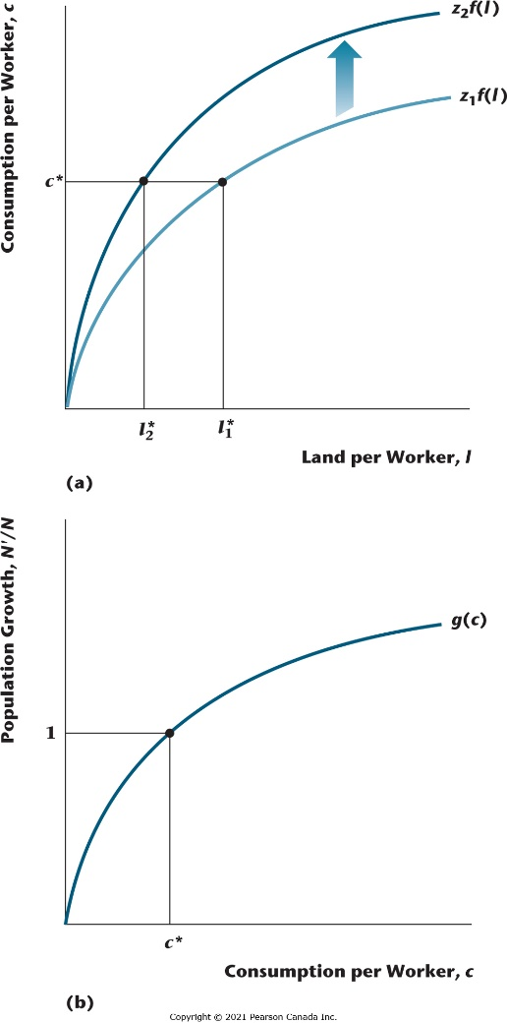
Figure 7.9 The Effect of an Increase in z in the Malthusian Model
When z increases, land per worker decreases in the steady state (so the population increases and consumption per worker remains the same).

Slide 26
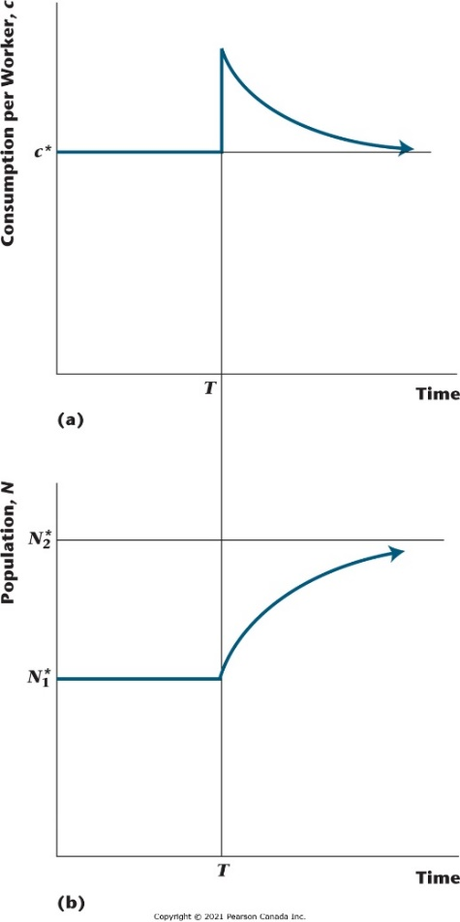
Figure 7.10 Adjustment to the Steady State in the Malthusian Model When z Increases
In the figure, z increases at time T, which causes consumption per worker to increase and then decline
to its steady state value over time, with the population increasing over time to its steady-state value.

Slide 27
Population Control in the Malthusian Model
Population control alters the relationship between population growth and per-capita consumption.
In the long run, per capita consumption increases, and living standards rise.

Slide 28
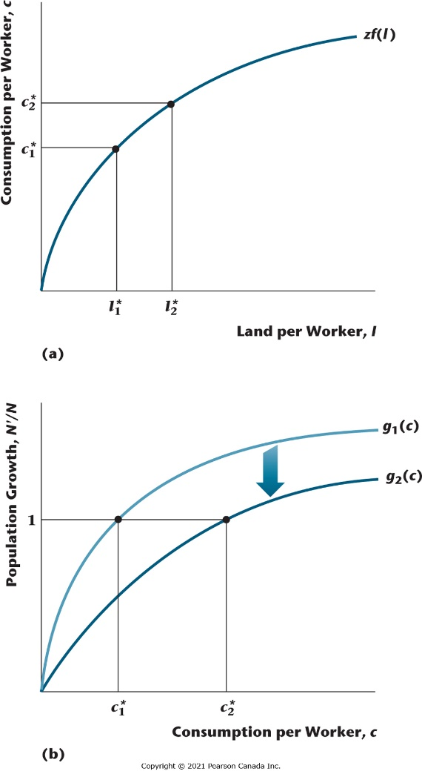
Figure 7.11 Population Control in the Malthusian Model
In the figure, population-control policy shifts the function g₁(c) to g₂(c). In the steady state, consumption per worker increases and land per worker decreases (the population falls).

Slide 29
How Useful is the Malthusian Model?
Model provides a good explanation for pre-1800 growth facts in the world.
Malthus did not predict the effects of technological advances on fertility.
Malthus did not understand the role of capital accumulation in growth.

Slide 30
Solow Growth Model
This is a key model which is the basis for the modern theory of economic growth.
A key prediction is that technological progress is necessary for sustained increases in standards of living.

Slide 31

Population Growth
In the Solow growth model, population is assumed to grow at a constant rate n.
$$N′=(1+n)N$$

Slide 32

Consumption-Savings Behaviour
Consumers are assumed to save a constant fraction s of their income, consuming the rest.
$$C=(1+s)Y$$

Slide 33

Representative Firm’s Production Function
$$Y=zF(K,N),$$

Slide 34
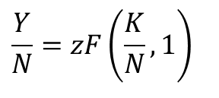
Constant Returns to Scale
Constant returns to scale implies:
$$\frac{Y}{N}=zF\left(\frac{K}{N},1\right)$$

Slide 35

Evolution of the Capital Stock
Future capital equals the capital remaining after depreciation, plus current investment.
$$K′=(1+d)K+I$$

Slide 36
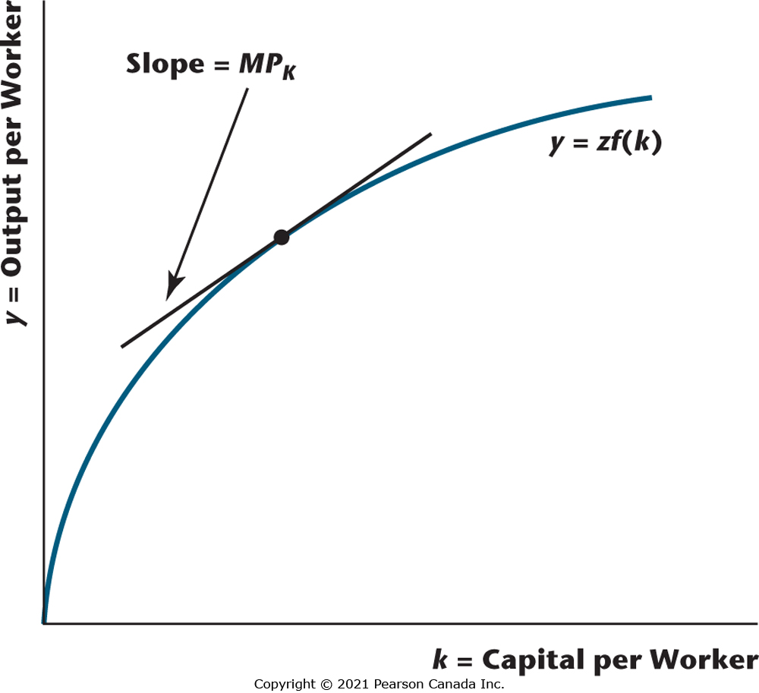
Figure 7.12 The Per-Worker Production Function
This function is the relationship between aggregate output per worker and capital per worker determined by the constant-returns-to-scale production function. The slope of the per-worker production function is the marginal product of capital, MP_{K}.

Slide 37

Income-Expenditure Identity
The income expenditure identity holds as an equilibrium condition.
$$Y=C+I$$

Slide 38

Equilibrium
In equilibrium, future capital equals total savings (= I) plus what remains of current K.
$$K′=sY+(1−d)K$$

Slide 39

Next Step
Substitute for output from the production function.
$$K′=szF(K,N)+(1−d)K$$

Slide 40
Then,
Rewrite in per-worker form.
$$K′=(1+n)=szf(K)+(1−d)K$$

Slide 41
Next,
Rearrange, to get:
$$K′=\left[szf(K)\right]/(1+n)+\left[(1−d)K\right]/(1−n)$$

Slide 42
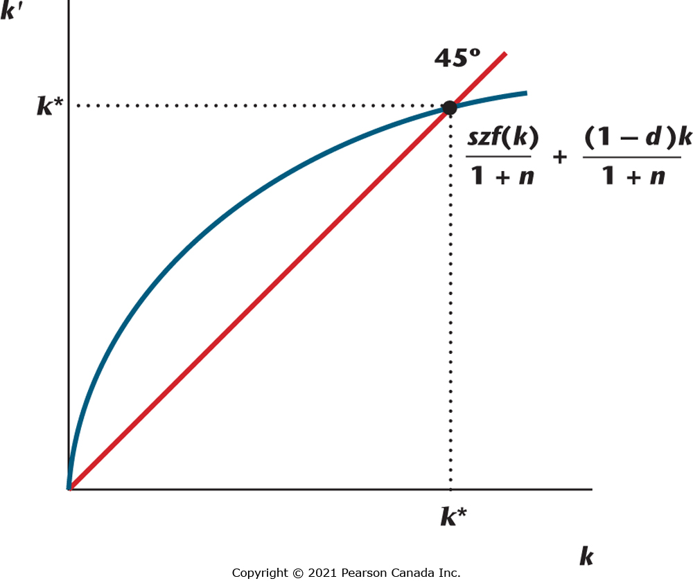
Figure 7.13 Determination of the Steady-State Quantity of Capital per Worker
In the figure, the blue curve is the relationship between current capital per worker, k, and future capital per worker, k, determined in a competitive equilibrium in the Solow growth model. The steady-state quantity of capital per worker is k*, given by the intersection of the 45° line (the red line) with the blue curve.

Slide 43
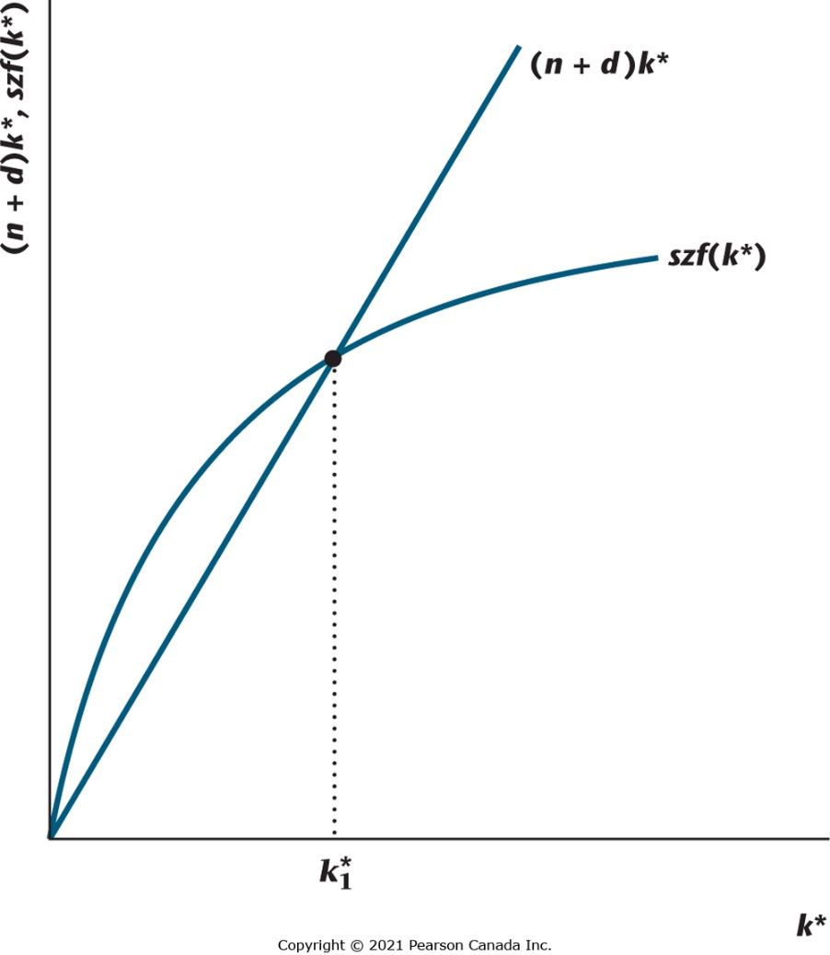
Figure 7.14 Determination of the Steady-State Quantity of Capital per Worker
The steady-state quantity of capital, k$\begin{matrix}∗ \\ 1\end{matrix}$ is determined by the intersection of the curve szf(k*) with the
line (n + d)k *.

Slide 44
An Increase in the Savings Rate s
In the steady state, this increases capital per worker and real output per capita.
In the steady state, there is no effect on the growth rates of aggregate variables.

Slide 45
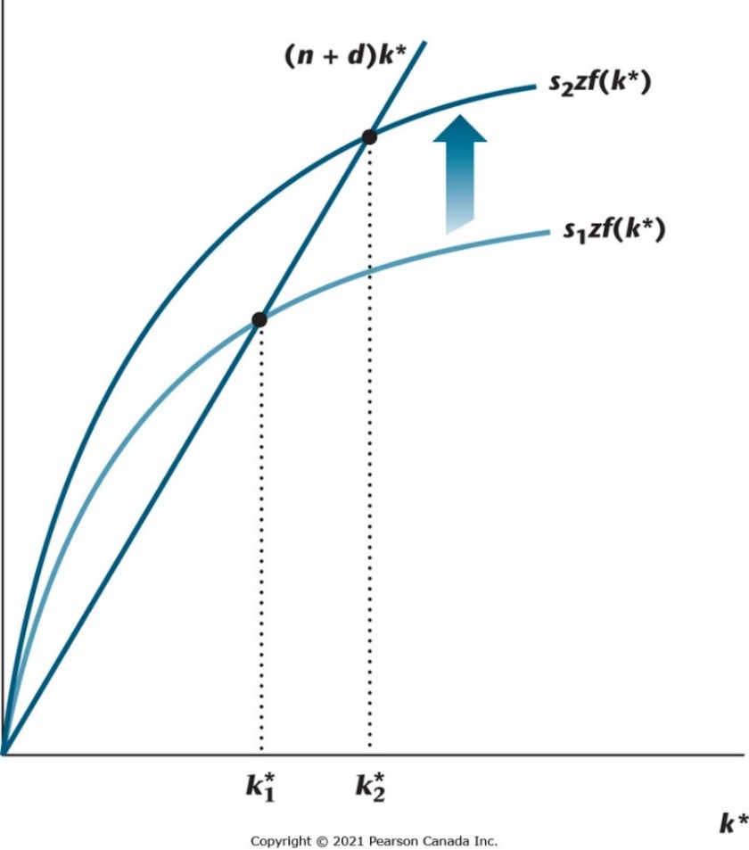
Figure 7.15 Effect of an Increase in the Savings Rate on the Steady-State Quantity of Capital per Worker
An increase in the savings rate shifts the curve szf(k*) up, resulting in an increase in the quantity of capital per worker from k$\begin{matrix}∗ \\ 1\end{matrix}$ to k$\begin{matrix}∗ \\ 2\end{matrix}$.

Slide 46
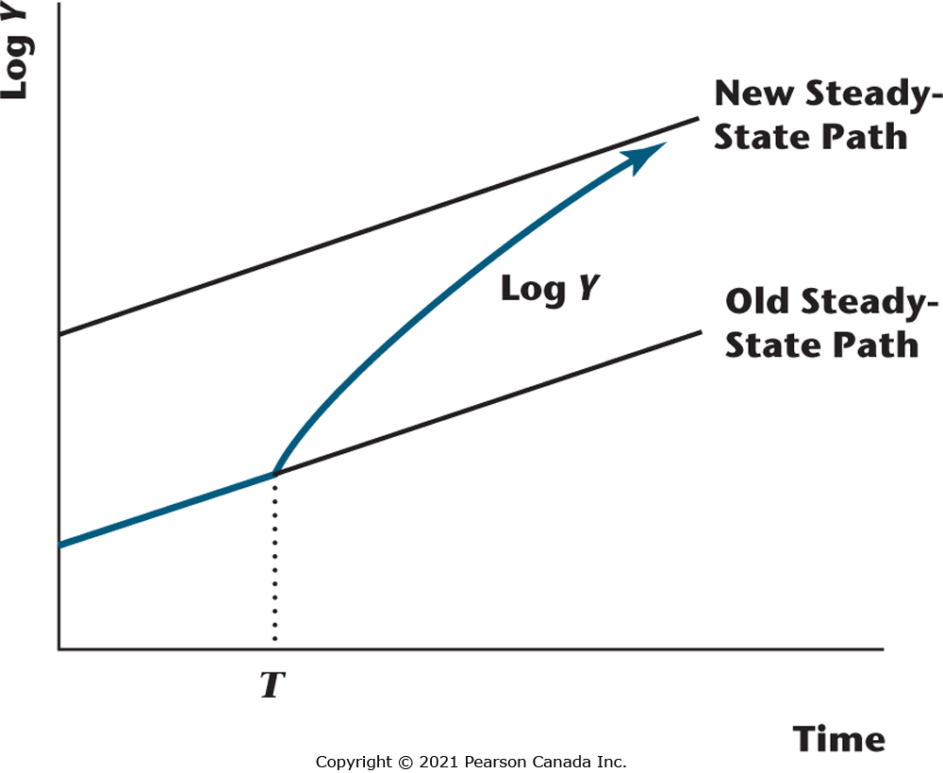
Figure 7.16 Effect of an Increase in the Savings Rate at Time T
The figure shows the natural logarithm of aggregate output. Before time T, the economy is in a steady state. At time T, the savings rate increases, and output then converges in the long run to a new higher steady-state growth path.

Slide 47
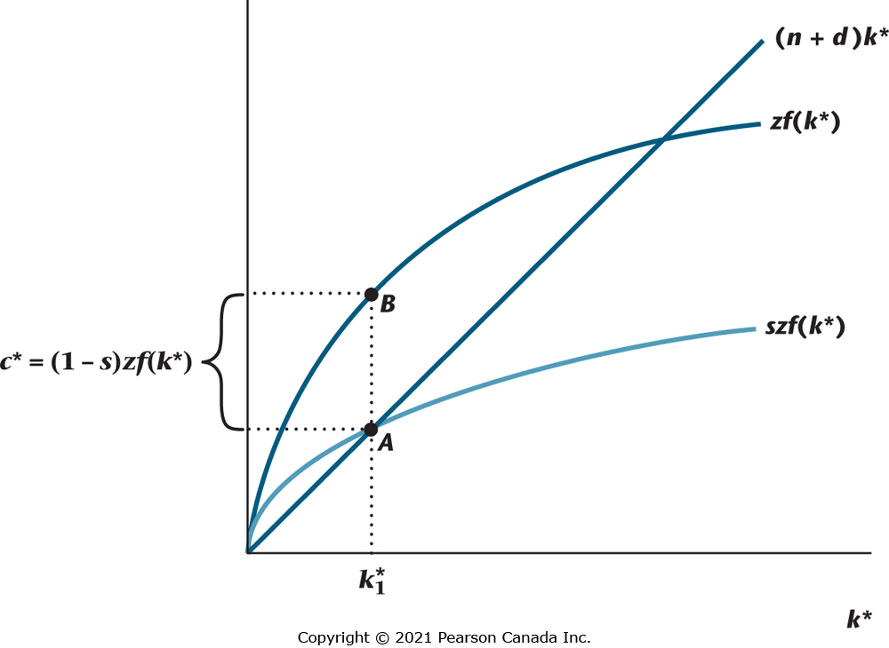
Figure 7.17 Steady-State Consumption per Worker
Consumption per worker in the steady state is shown as the distance AB, given the steady-state quantity of capital per worker, k$\begin{matrix}∗ \\ 1\end{matrix}$.

Slide 48
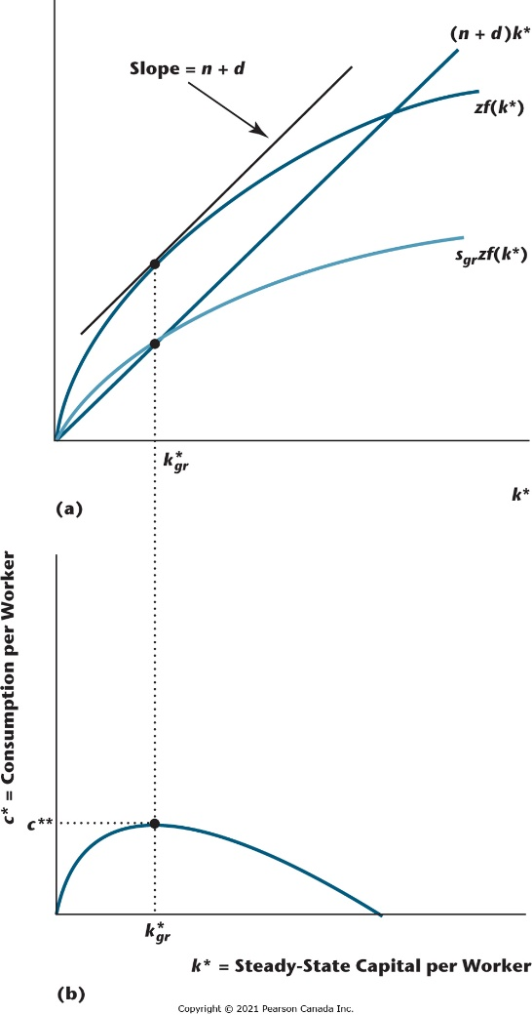
Figure 7.18 The Golden Rule Quantity of Capital per Worker
This quantity, which maximizes consumption per worker in the steady state, is k$\begin{matrix}∗ \\ gr\end{matrix}$, and the maximized quantity of consumption per worker is c**. The golden rule savings rate s_{g}r achieves the golden rule quantity of capital per worker in a competitive equilibrium steady state.

Slide 49
An Increase in the Population Growth Rate n
Capital per worker and output per worker decrease.
There is no effect on the growth rates of aggregate variables.

Slide 50
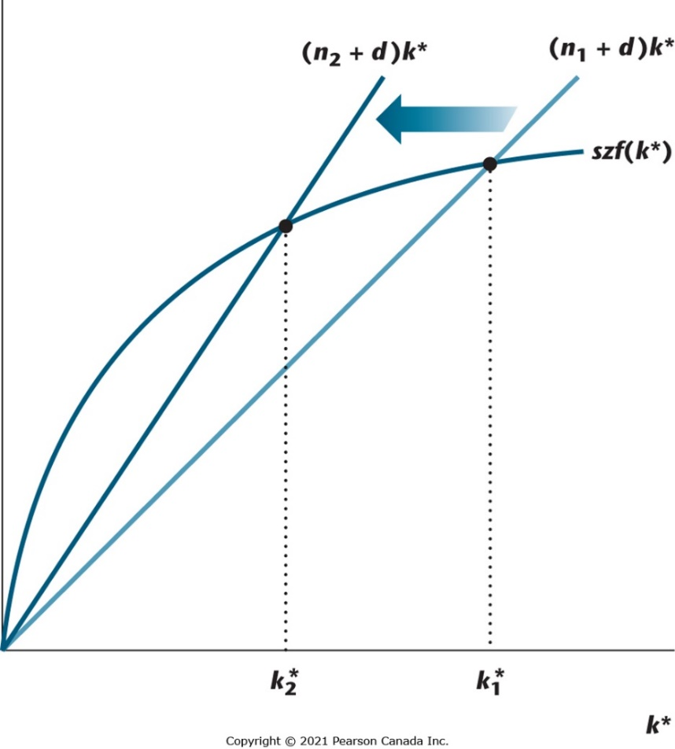
Figure 7.19 Steady State Effects of an Increase in the Labour Force Growth Rate
An increase in the labour force growth rate from n₁ to n₂ causes a decrease in the steady-state quantity of capital per worker.

Slide 51
Increases in Total Factor Productivity z
Sustained increases in z cause sustained increases in per capita income.

Slide 52
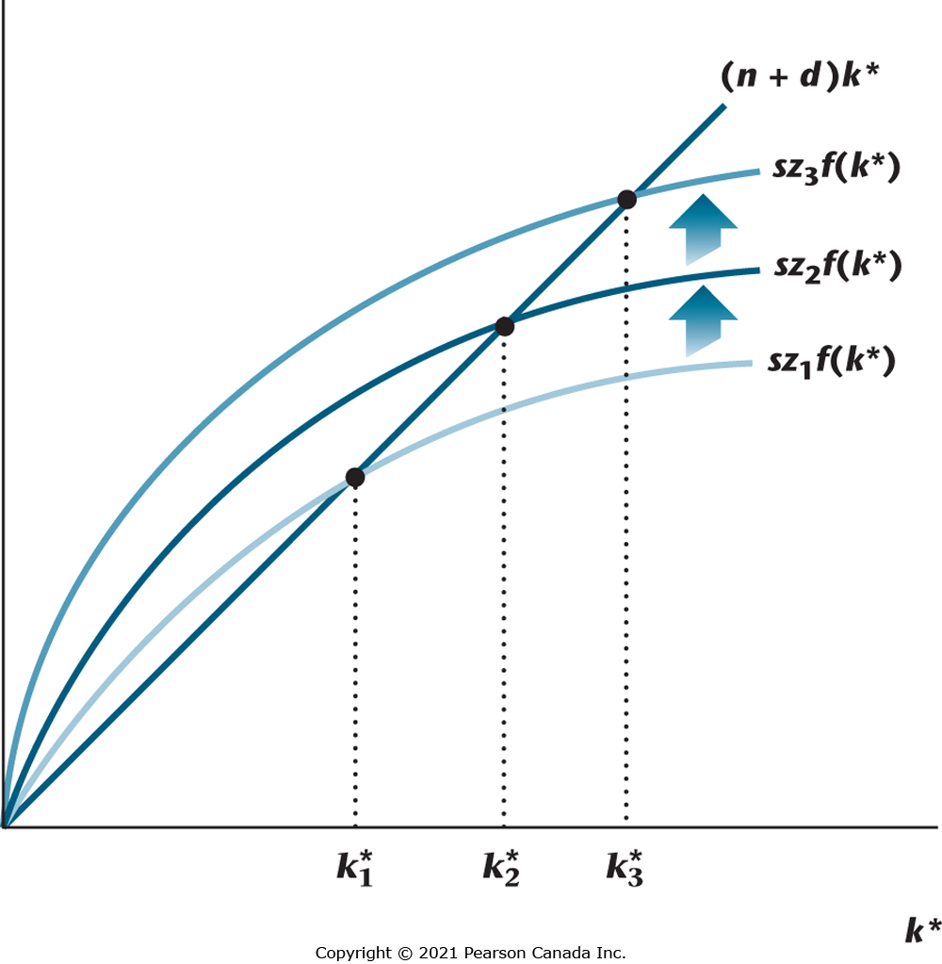
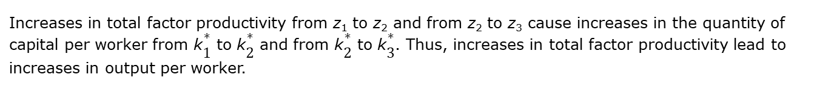
Figure 7.20 Increases in Total Factor Productivity in the Solow Growth Model
Increases in total factor productivity from z₁ to z₂ and from z₂ to z₃ cause increases in the quantity of capital per worker from k$\begin{matrix}∗ \\ 1\end{matrix}$ to k$\begin{matrix}∗ \\ 2\end{matrix}$ and from k$\begin{matrix}∗ \\ 2\end{matrix}$ to k$\begin{matrix}∗ \\ 3\end{matrix}$. Thus, increases in total factor productivity lead to increases in output per worker.

Slide 53
Growth and the Distribution of Income
Measuring income inequality in a country.
What does the Solow growth model have to say about the distribution of income across the population in a given country?

Slide 54
The Lorenz Curve
Lorenz curve provides a nice visual summary of the income distribution in a country.
Lorenz curve plots the percentage of income earned by percentiles of the population against those percentiles.
If everyone earns the same income, the Lorenz curve is the 45 degree line.
If one person gets all the income, the Lorenz curve is a reverse-L shape.
The Gini coefficient is a measure of income inequality.

Slide 55
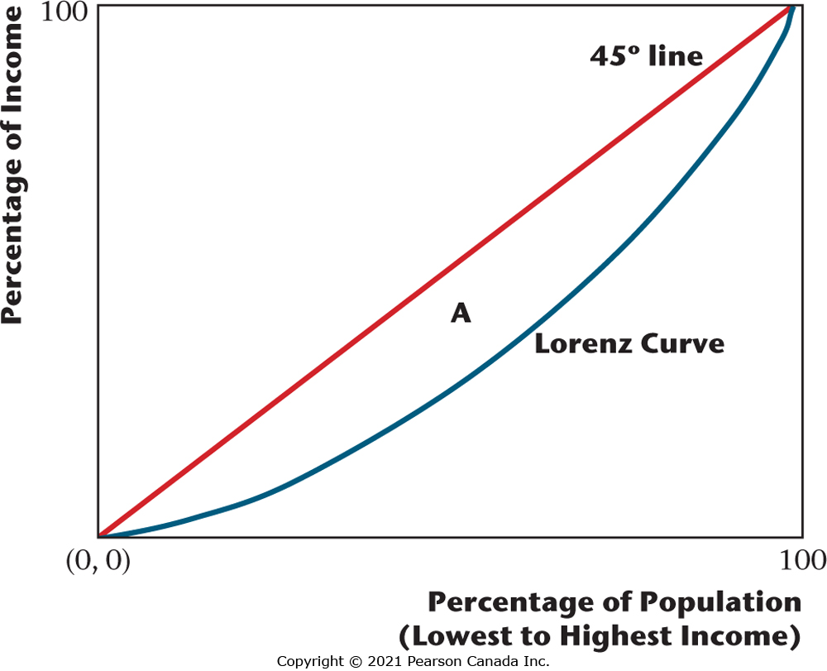
Figure 7.23 The Lorenz Curve
This curve gives us a visual representation of the distribution of income across the population. Equal
distribution implies that the Lorenz curve is the 45° line. The area of region A, divided by the area of
the region below the 45° line is the Gini coefficient. A larger Gini coefficient implies greater dispersion
in the income distribution.

Slide 56
From the World Bank, Gini Coefficients for 2013
Canada: 0.34
United States: 0.41
France: 0.325
China: 0.397
Sweden: 0.288
So, the United States and China have higher income dispersion (greater inequality) than Canada, and France and Sweden have less.

Slide 57
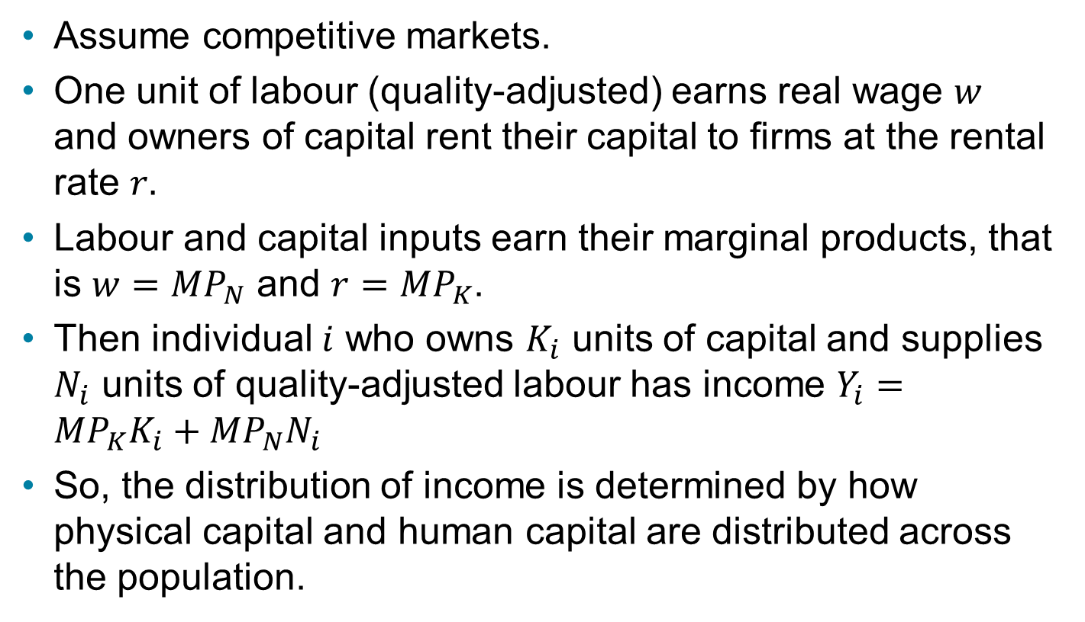
The Solow Growth Model and the Income Distribution
Assume competitive markets.
One unit of labour (quality-adjusted) earns real wage $w$ and owners of capital rent their capital to firms at the rental rate $r.$
Labour and capital inputs earn their marginal products, that is $w={MP}_{N}$ and ${r=MP}_{K}$.
Then individual $i$ who owns $K_{i}$ units of capital and supplies $N_{i}$ units of quality-adjusted labour has income $Y_{i}={MP}_{K}K_{i}+{MP}_{N}N_{i}$
So, the distribution of income is determined by how physical capital and human capital are distributed across the population.

Slide 58
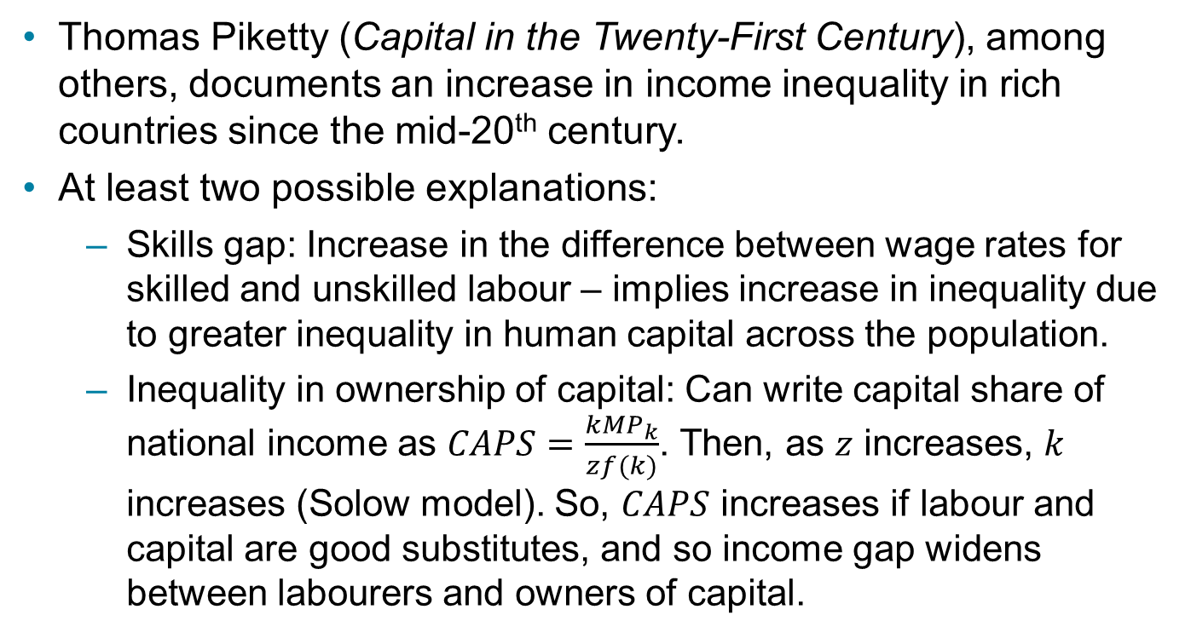
What Explains the Increase in Income Dispersion?
Thomas Piketty (Capital in the Twenty-First Century), among others, documents an increase in income inequality in rich countries since the mid-20th century.
At least two possible explanations:
Skills gap: Increase in the difference between wage rates for skilled and unskilled labour – implies increase in inequality due to greater inequality in human capital across the population.
Inequality in ownership of capital: Can write capital share of national income as $CAPS=\frac{k{MP}_{k}}{zf(k)}$. Then, as $z$ increases, $k$ increases (Solow model). So, $CAPS$ increases if labour and capital are good substitutes, and so income gap widens between labourers and owners of capital.

Slide 59
Growth Accounting
An approach that uses the production function and measurements of aggregate inputs and outputs to attribute economic growth to: (i) growth in factor inputs; (ii) total factor productivity growth.

Slide 60

Cobb-Douglas Production Function (1 of 2)
$$Y=szf(K,N)=zK^{a}N^{1−a}$$

Slide 61

Cobb-Douglas Production Function (2 of 2)
A labour share in national income of 70% gives:
$$Y=zK^{0.3}N^{0.7}$$

Slide 62
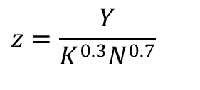
Solow Residual
The Solow residual is calculated as:
$$z=\frac{Y}{K^{0.3}N^{0.7}}$$

Slide 63
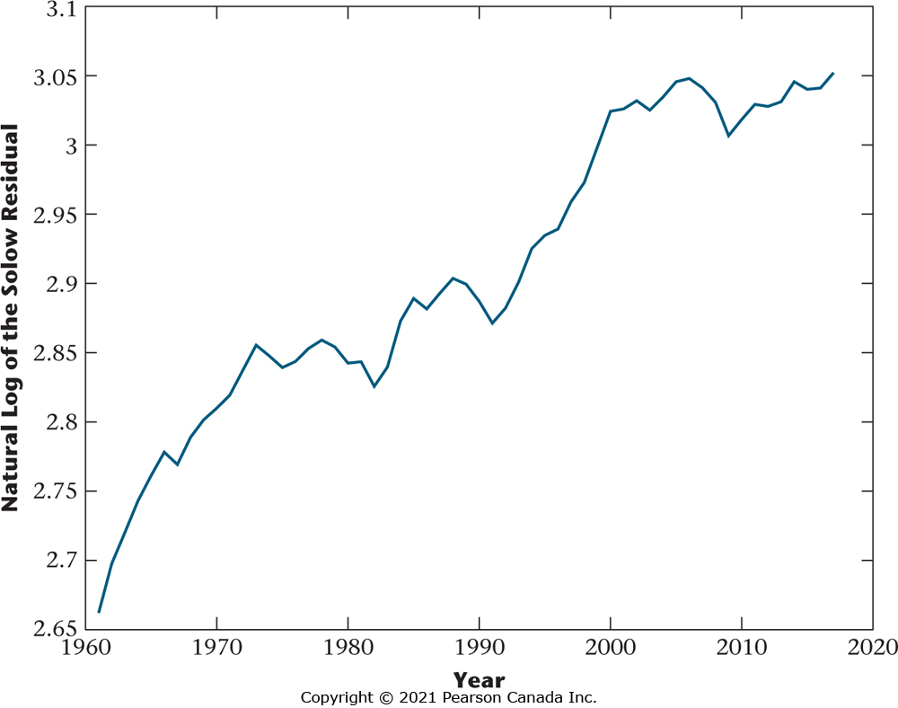
Figure 7.24 Natural Log of the Solow Residual, 1961–2017
The Solow residual is a measure of total factor productivity. Growth in total factor productivity slows from the early 1970s to the early 1990s, and from 2000 to 2017.

Slide 64
Average Annual Growth Rates in the Solow Residual
Years | Average Annual Growth Rate
1961-1971 | 1.59%
1971-1981 | 0.24%
1981-1991 | 0.28%
1991-2001 | 1.56%
2001-2011 | 0.03%
2011-2017 | 0.38%

Slide 65
Average Annual Growth Rates
Years | Y | K | N | z
1961-1971 | 5.17 | 4.94 | 2.92 | 1.59
1971-1981 | 3.99 | 4.50 | 3.42 | 0.24
1981-1991 | 2.07 | 2.94 | 1.30 | 0.28
1991-2001 | 3.25 | 2.03 | 1.50 | 1.56
2001-2011 | 1.99 | 3.18 | 1.44 | 0.03
2011-2017 | 1.95 | 2.58 | 1.12 | 0.38

